Slide 1
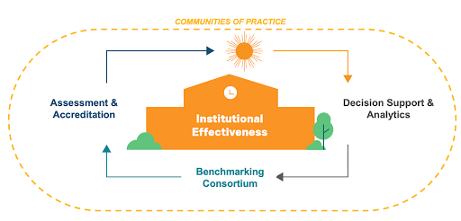
Institutional Effectiveness 2.0 in Action Empowering Stakeholders to Lead Beyond Their Role
AEFIS Academy Community Events
Thursday, January 27, 2022 | 2:00-3:00 PM ET
Your center for communities of practice.
Learn. Teach. Collaborate. Innovate.
Notes:
Opening: Hello and Welcome to AEFIS Academy Community Event “Institutional Effectiveness 2.0 in Action—Empowering Stakeholders to Lead Beyond Their Role.”
Today is Thursday, January 27, 2022 and it is 2:00 PM Eastern.
Before we begin, a few housekeeping items: First, this event is being recorded and will be available on AEFIS Academy to all Community Members. Next, you have been muted upon joining the webinar. We ask that all questions be submitted in the Zoom chat, and we will allocate time throughout the presentation for your participation and for Q&A at the end.

Slide 2
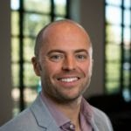
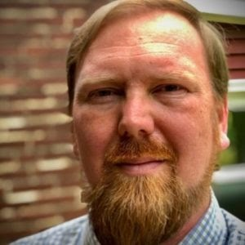
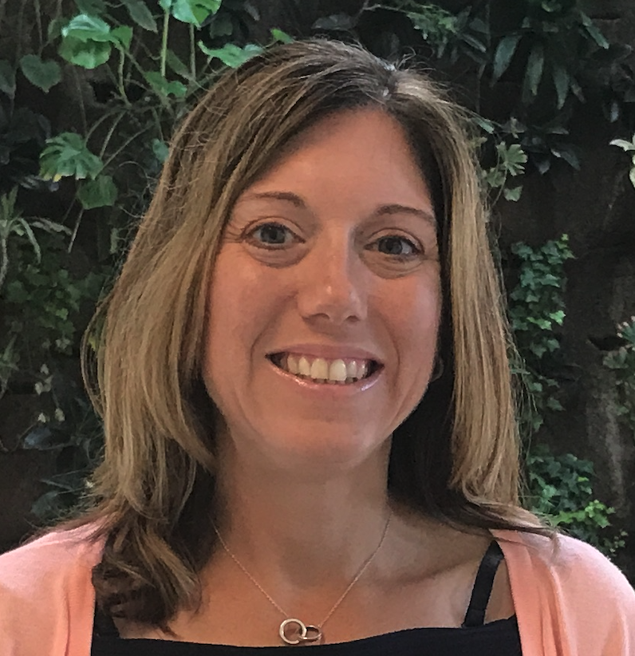
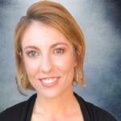
Our Presenters
AEFIS Academy Community Events
Dr. Mike Rudolph Director of Institutional Effectiveness University of Kentucky | Dr. Colin Suchland Chair, Learning Outcomes Assessment Team, Professor of Sociology Lincoln Land Community College | Suzanne Carbonaro Director of Academic Partnerships HelioCampus | Dr Tasha Almond-Dannenbring Sr. Data Analyst HelioCampus
Your center for communities of practice.
Learn. Teach. Collaborate. Innovate.
Notes:
Institutional Effectiveness 2.0 in action requires a new way of leading, collecting data, and using data to inform decision-making. It requires leaders to empower their faculty and staff to not only contribute to an institution’s success but give them room to lead beyond their titles to accelerate success within their department, college, or unit. And ensuring that stakeholders have meaningful data at their fingertips to tell success stories and write new ones fosters the necessary decision-making power required for improvement and change across an institution. Learn from leaders at the University of Kentucky and Lincoln Land Community College who are leading their institution to think beyond their titles to transform theories of change into action, establish communities of practice, and drive continuous improvement using data to elevate effectiveness, foster sustainability, and a clear return on investment for students.
Today we’re excited to welcome practitioners who are leading their organizations from their role and in alignment with their organizational mission and culture. I am thrilled to introduce Dr. Mike Rudolph, Dr. Colin Suchland and Dr. Tasha Almond-Dannenbring. Thank you for being here and for your service to higher education.

Slide 3
Outcomes
Identify methods to empower your stakeholders to lead beyond their title at your institution
Design an institutional change strategy that is responsive to the current culture and serves as a catalyst for the future
Determine the scope of need for resources and training for your guiding coalition to be successful
Notes:
Today’s outcomes include

Slide 4
What is Institutional Effectiveness 2.0?
Notes:
From your role/roles how do you define this for your institution.
Mike,
Colin,
TAD: I have served in both a roles as an IR director and IE director. Institutional Effectiveness 2.0 to me, encompasses IR. Institutional Effectiveness has evolved and is critical for an institution that wishes to use data strategically to inform decisions. The IE office has oversight of a robust cadre of data elements, with the ability to understand the importance of the granularity of the data and operational use of data, the IE office also evaluates a problem wholistically because of their oversight of so many data elements of their institution. I had luxury as an IE Director to have a direct report to the CEO/President, this allowed me the flexibility to have access and insight into all critical operational areas and to equip the administration with the data necessary to make informed and strategic decisions. I believe the IE 2.0 involves the ability to be able to zoom in on critical data elements and anticipate analytics needs, and evaluate multiple areas of data wholistically.

Slide 5
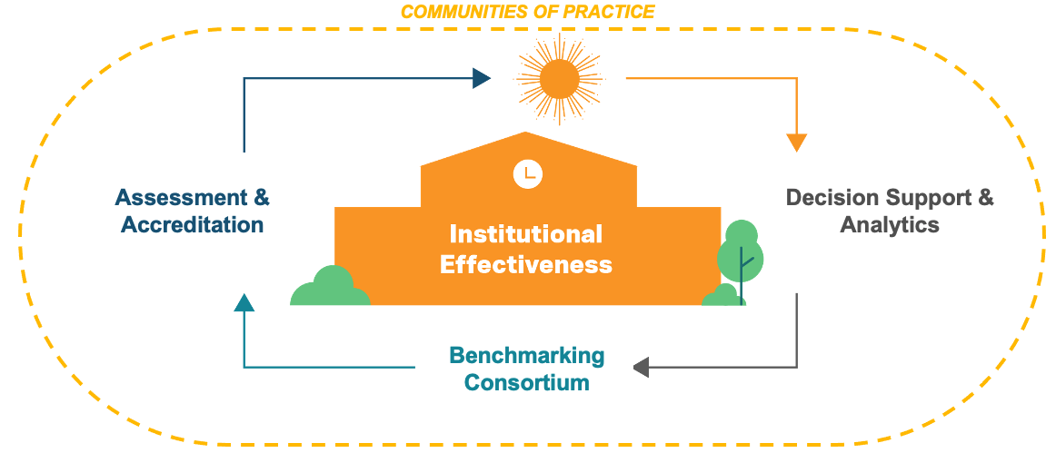
Who We Are
Together, we are supporting a comprehensive approach to Institutional Effectiveness
Notes:
I have been working in higher education as a ie and assessment practitioner for most of my career and it is clear that the office ie and its purpose is changing.
What do we mean by IE 2.0?
A combination of internal and external factors are driving institutions to seek ways to better align their investments with financial and student learning outcomes
Accreditation bodies in particular are driving some of this evolution are now requiring colleges and universities to provide measurable evidence of institutional effectiveness through the lens of financial sustainability and student success. This means engaging your stakeholders in assessment and even asking theml, empowering them with the resources to lead beyond their classrooms and their roles.
In the spirit of this, I wanted to share an example of this via a recent AAC&U article by Dr. Elise Demeter who is a senior assessment research analyst and an associate graduate faculty member at the University of North Carolina at Charlotte.
Reflecting on Course Redesign: How Faculty Can Measure the Impact of Instructional Changes- AAC&U Article from August 2021 https://web.archive.org/web/20210825031333/https://www.aacu.org/blog/reflecting-course-redesign-how-faculty-can-measure-impact-instructional-changes
Here she provides a road map that can help enable your faculty design and implement a plan to improve student learning in their courses using data; which means they need the resources and access to meaningful data to do this important work And IE 2.0 can help.
Assessment & Accreditation: Evaluate student learning outcomes, provide evidence of learning and skills development and support institutional accreditation
Decision Support & Analytics
Drive student success & grow revenue
Maximize returns of academic programs
Manage costs & streamline operations
Provide an institutional analytics capability to colleges and universities
Benchmarking: Benchmark against peers for academic and administrative efficiency
I have been working with this organization for XXX years. I
I was part of the AEFIS team and we recently joined forces with HelioCampus to collectively support a comprehensive approach to Institutional Effectiveness.
Given the nature of this conference (SACSCOC), we are focused on our Assessment and Accreditation business line. That said, if you’re interested in learning more about our decision support and analytics or benchmarking consortium, I’m happy to follow-up.
IE offices covering multiple areas
ADDITIONAL NOTES - not needed for SACSCOC
==================================
Helping colleges and universities better align investments with financial and student learning outcomes.
AEFIS joining HelioCampus accelerates our ability to support what we’re calling Institutional Effectiveness 2.0. What do we mean by IE 2.0?
A combination of internal and external factors are driving institutions to seek ways to better align their investments with financial and student learning outcomes
Accreditation bodies in particular are driving some of this evolution are now requiring colleges and universities to provide measurable evidence of institutional effectiveness through the lens of financial sustainability and student success.
As you see here, we believe the formula for Institutional Effectiveness 2.0 will require a comprehensive approach that supports accreditation, financial sustainability and student success initiatives.
Some of you may already be partnering with HelioCampus for decision support and analytics.
Others may be partnering with HelioCampus for administrative and academic benchmarking through the consortium.
AEFIS brings a comprehensive, all-in-one approach to assessment, accreditation and lifelong learning
Together, we will become the premier institutional effectiveness and analytics provider for colleges and universities seeking to better align investments with financial and student learning outcomes.
And we’ll continue to focus on building communities of practice, whether they are clients/members/partners of HelioCampus or not.
====================================
ADDITIONAL DETAILS
We are going to have 3 complementary lines of business that support each other and allow us to deliver on our vision for IE 2.0. Institutions can work with us on one component or all 3. And we’ll have a focus on building communities of practice, whether they are clients/members/partners of HelioCampus or not.
As we shared in our announcement at the end of September, HelioCampus and AEFIS combine to become the premier institutional effectiveness and analytics provider for colleges and universities seeking to better align investments with financial and student learning outcomes.
Details about each area
Assessment & Accreditation: Evaluate student learning outcomes, provide evidence of learning and skills development and support institutional accreditation
Decision Support & Analytics
Drive student success & grow revenue
Maximize returns of academic programs
Manage costs & streamline operations
Provide an institutional analytics capability to colleges and universities
Benchmarking: Benchmark against peers for academic and administrative efficiency

Slide 6
What change leadership strategies have you employed to empower your coalition to lead beyond their title?
Notes:
So, at this point we are going to dive into more case studies from our panelists who leading IE 2.0 and putting into action methodologies to support their stakeholders in owning and leading assessment from their role. I want to first turn it over to Mike Rudolph.
Mike: Kotter
Colin: LOAT
Tasha: Similar to Colin’s use of the LOAT, I have employed this on a system level scale, with discipline councils made up of faculty from similar discipline areas from across multiple universities and campuses. Inviting these faculty to serve as the institutional assessment representative and subject matter expert on the System Gen Ed Council, their input and insight was critical to shaping the System Assessment policy. We also deployed discipline councils in each of the outcome areas with faculty representatives from across the system in that subject area. With faculty lead discipline councils, the various campus constituents were able to share best practices… this enabled the system to have a robust general education assessment plan and process. One activity that was particularly impactful at the beginning of implementation of the new General Education Policy were assessment summits, where faculty came together to refine rubrics and review artifacts that had been collected from various GenEd classes in their subject area from across the system.

Slide 7
What barriers or challenges have you faced along the way?
Notes:
Colin, Tasha, Mike
Problem of practice have you faced.
Tangible examples from all three panelists
Consistency- Blackboard to Canvas
Adjuncts
Unifying
Transparency
Moving Faculty- small wins with faculty
One item/scaffold/chunk/achievable
Lean in on collaboration
No such thing as one size fits all assessment
Technology does not solve assessment issue/power way to get people to the same place.
TAD - The process for the collection and review of assessment data was one barrier we experienced. One way that we addressed this was to keep a focus on what was achievable, and utilizing faculty assessment champions in Math and English as the first two subject areas we wanted to approach for general education assessment. These two faculty groups critically evaluated how this process would work for their campus and the system. We also faced the barrier of a technology solution to use in conjunction with the process, and Colin and Mike can speak to the benefits in utilizing a technology tool to ease some of this challenge that we experienced.

Slide 8
What professional learning resources have helped support your coalition to build confidence in assessment of teaching and learning?
Notes:
TAD - at the board of regents, peer to peer learning was valuable, as I mentioned before we were able to host multiple assessment summits in which faculty came together to engage in in-depth conversation and working sessions around the rubrics and outcomes in the assessment plan. This also served as a way for faculty to build relationships across the system which fostered further collaboration and partnership.
Mike, Colin
Professional learning resources - what has helped….
Champions of assessment - PLC (resource from within) Peer to peer learning
AEFIS Academy course (show it)- retreat for department assessment leaders

Slide 9
How can leaders take what they learned today and begin IE 2.0 initiatives tomorrow?
Notes:
Provide resources
Mike Kotter’s Change leadership that a starting point based on culture
TAD - Identify ways to embrace Kotter’s theory as a norm in institutional operations at all levels.
Colin Blog
Find that champion of assessment- critical piece move the needle
Embrace Kotter to run IE office

Slide 10
Q&A
AEFIS Academy Community Events
Dr. Mike Rudolph Director of Institutional Effectiveness University of Kentucky | Dr. Colin Suchland Chair, Learning Outcomes Assessment Team, Professor of Sociology Lincoln Land Community College | Suzanne Carbonaro Director of Academic Partnerships HelioCampus | Dr Tasha Almond-Dannenbring Sr. Data Analyst HelioCampus
Your center for communities of practice.
Learn. Teach. Collaborate. Innovate.
Notes:
Let’s take a few minutes to answer some questions or chat about some of the topics you have been discussing in Zoom chat.

Slide 11
Community Blog
AEFIS Academy Community Events
Agents of Lasting Change:
Creating Sustainable Faculty Development
Dr. Colin Suchland
Chair, Learning Outcomes Assessment Team, Professor of Sociology
https://www.aefisacademy.org/agents-of-lasting-change-creating-sustainable-faculty-development/
Your center for communities of practice.
Learn. Teach. Collaborate. Innovate.
Notes:
https://www.aefisacademy.org/agents-of-lasting-change-creating-sustainable-faculty-development/

Slide 12
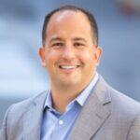
Community Blog
AEFIS Academy Community Events
Preparing for Institutional Effectiveness 2.0 —
A Q&A With Darren Catalano
 | Darren Catalano CEO
https://www.aefisacademy.org/preparing-for-institutional-effectiveness-2-0-a-qa-with-darren-catalano/
Your center for communities of practice.
Learn. Teach. Collaborate. Innovate.
Notes:
https://www.aefisacademy.org/preparing-for-institutional-effectiveness-2-0-a-qa-with-darren-catalano/

Slide 13
AEFIS Academy Community Events
Your Institutional Effectiveness Innovation Hub
https://www.aefisacademy.org/content-hubs/your-institutional-effectiveness-hub/
Your center for communities of practice.
Learn. Teach. Collaborate. Innovate.
Notes:
https://www.aefisacademy.org/content-hubs/your-institutional-effectiveness-hub/

Slide 14
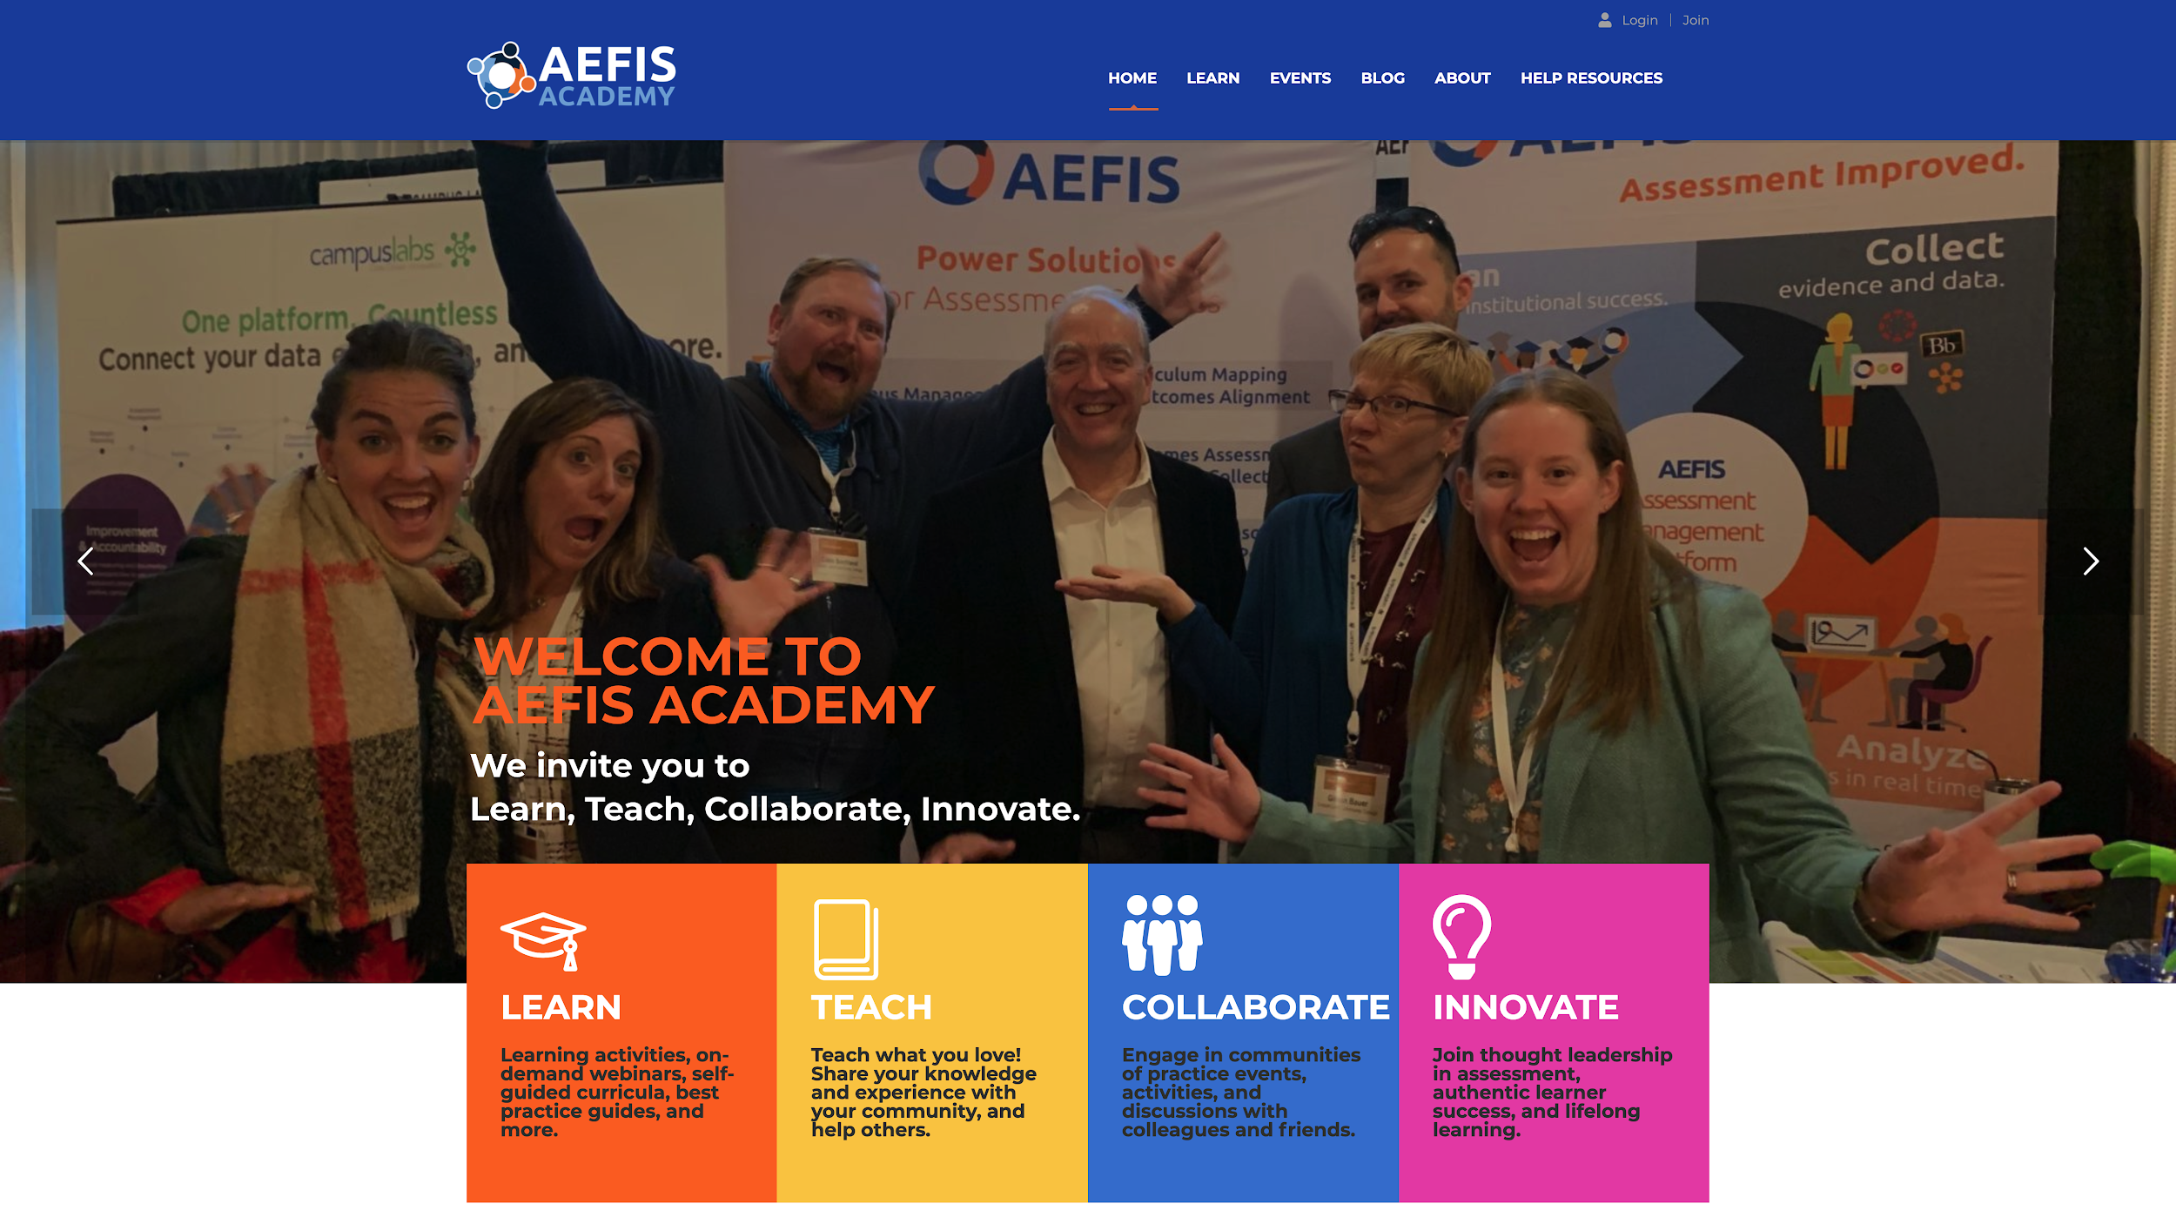
Your center for communities of practice.
Learn. Teach. Collaborate. Innovate.
Community Events
Training Materials
Help Resources
Client Support
www.aefisacademy.org
Notes:
And you can catch this and other community events on AEFIS Academy. As members of the community, you have access to the latest and greatest resources to support your initiatives at your institution! I am Suzanne Carbonaro and from myself and the AEFIS Team, thank you for joining and Have a terrific rest of your day!

